Slide 1
Flood monitoring & early warning system
TEAM NAME: TEAM MEMBERS:1.RAMKUMAR.N(113321104079)
Proj_224785_Team_2 2.RANJITH.Y(113321104080)
3.SANTHOSH.K(113321104085)
4.SANTHOSH.N(113321104086)
Phase 2: Innovation

Slide 2
Project Objectives :
1.Data Transmission and Connectivity: Establish a robust communication infrastructure to ensure seamless data transmission from sensors to a central server or cloud platform, even in adverse weather conditions.2
2.Real-Time Data Collection: Implement IoT sensor networks to collect real-time data on critical parameters such as water level, rainfall, weather conditions, and river/stream flow rates.
3.Data Processing and Analysis: Develop data analytics and machine learning algorithms to process and analyze the collected data for early flood detection, risk assessment, and prediction.
4.Threshold-Based Alerting: Set up threshold values for each parameter and create an automated alert system that triggers warnings when these thresholds are exceeded, signaling the potential for flooding.
5.Multi-Channel Warning Dissemination: Design a warning system that can disseminate alerts and warnings via multiple communication channels, including SMS, mobile apps, sirens, email, and social media.
6.Geospatial Mapping and Visualization: Create user-friendly geospatial maps and visualization tools to display real-time flood-related information, including flood extents, affected areas, and evacuation routes.
7.Public Awareness and Education: Develop educational materials and campaigns to raise public awareness about flood risks, the use of the early warning system, and appropriate response procedures.
8.Integration with Emergency Services: Integrate the flood monitoring system with local emergency services and authorities to ensure coordinated response efforts during flood events.

Slide 3
9.Remote Monitoring and Control: Enable remote monitoring and control of the IoT system, allowing administrators to adjust sensor parameters, update warning thresholds, and perform system maintenance remotely.
10.Historical Data Logging: Maintain a historical database of flood-related data for post-event analysis, trend identification, and continuous improvement of the warning system.
11.Scalability and Expansion: Design the system with scalability in mind to accommodate future sensor deployments and expand coverage to additional flood-prone areas.
12.Cost-Effective Maintenance: Develop a cost-effective maintenance plan to ensure the longevity of sensors and communication infrastructure while minimizing operational costs.
13.Regular Testing and Drills: Conduct regular system testing, drills, and simulations to ensure that all stakeholders are familiar with the warning system and response procedures.
14.Compliance with Regulations: Ensure that the system complies with relevant regulations, standards, and data privacy laws governing IoT and disaster management.
15.Continuous Improvement: Establish a process for continuous improvement by regularly reviewing system performance, analyzing user feedback, and incorporating technological advancements.
Meeting these objectives will help create an effective flood monitoring and early warning system using IoT technology, which can significantly reduce the impact of flood disasters on communities and infrastructure.

Slide 4
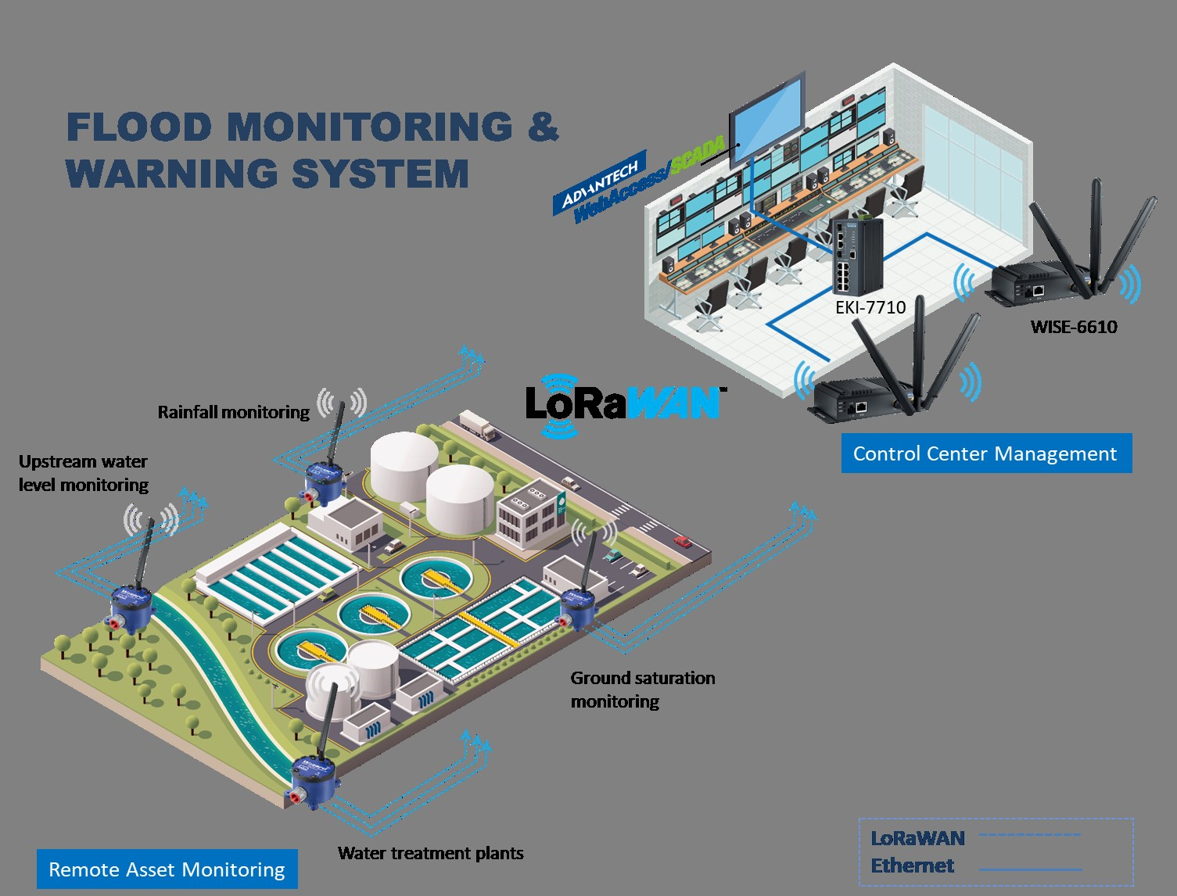
Virtualization diagram on IOT :

Slide 5
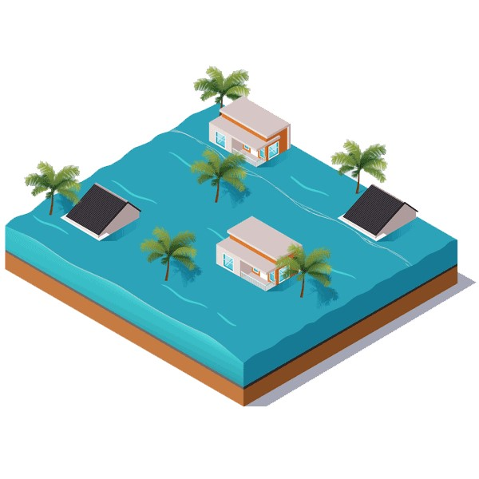
IOT SENSOR :
1.Identifying key parameters:
1.Water level
2.Rainfall intensity
3.Weather e.g., temperature, humidity, wind speed)
4.River/stream flow rates
2.Sensor Selection:
1.Water level sensors can use ultrasonic, pressure, or radar technology.
2.Rain gauges for measuring rainfall intensity can be tipping bucket or optical sensors.
3.Weather conditions can be monitored using a combination of sensors (e.g., temperature and humidity sensors, anemometers).
4.River/stream flow rates may require specialized flow sensors.
3.Power Supply:
1. Solar panels for remote locations
2.Battery backups for continuous operation during power outages
3.Low-power consumption to extend battery life
4.Environmental Protection:
1.Sensors are housed in weatherproof and rugged enclosures to protect them from adverse environmental conditions.
2.It includes heavy rainfall.

Slide 6
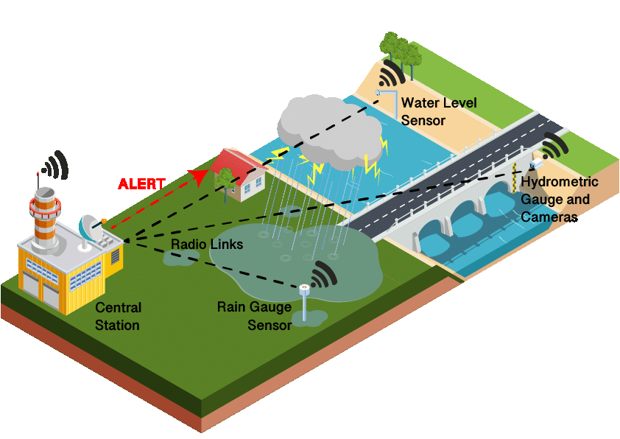
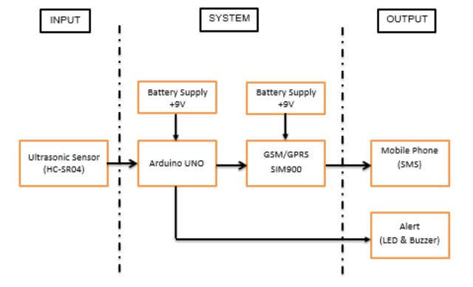
5.Remote Monitoring and Control:
1.Sensor settings.
2.perform maintenance.
3.troubleshoot issues remotely.
6.Security Measures:
1.Implement security measures to protect sensor data.
2.Prevent tampering.
3.Use encryption for data transmission and authentication mechanisms for data access.
7.Real-Time Clock (RTC): Include an RTC module to timestamp data accurately
1.Enabling synchronization with other sensors.
2.Systems.

Slide 7
RASPBERRY PI
INTEGRATION :
Raspberry Pi is a popular single-board computer that is widely used for various projects, including robotics, home automation, and educational purposes. To integrate Raspberry Pi with a smart home system, you can follow these steps:
1.Hardware Setup: Connect the Raspberry Pi to the smart home system by using a suitable communication protocol, such as Wi-Fi or Bluetooth. Additionally, connect any sensors or actuators required for the project.
2.Software Setup: Install the necessary software on the Raspberry Pi, such as an operating system (e.g., Raspbian), programming languages (e.g., Python), and libraries for interfacing with the smart home system.
3.Programming: Write a program on the Raspberry Pi that can communicate with the smart home system. This program should be able to send commands to control the smart home devices and receive updates about the current state of the smart home system.
4.Testing: Test the program by running it on the Raspberry Pi and observing the behavior of the smart home system. Make any necessary adjustments to the program based on the test results.
5.Automation: Set up the Raspberry Pi to automatically run the program at specific intervals or in response to specific events. This can be achieved by using tools like cron jobs on Linux or Task Scheduler on Windows.
6.Security: Implement security measures to protect the Raspberry Pi and the smart home system from unauthorized access and potential threats. This may involve using encryption, secure communication protocols, and strong authentication methods.
By following these steps, you can successfully integrate a Raspberry Pi into a smart home system and create a wide range of automation and control features for your home.</s

Slide 8
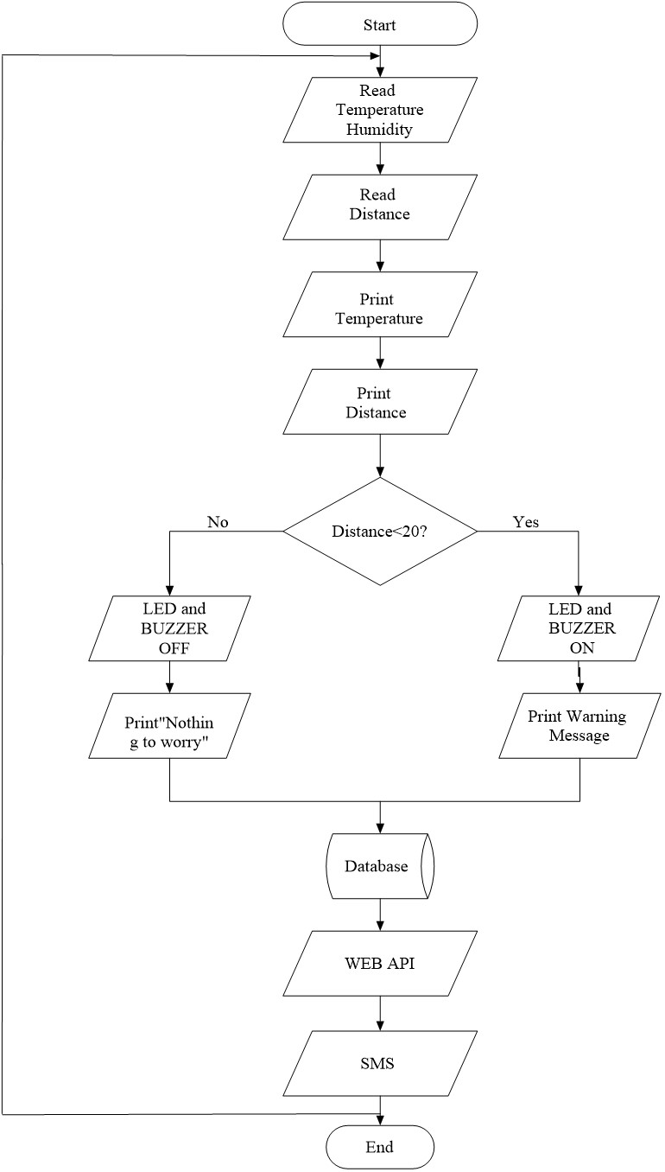

Slide 9
Aspect | Description |
|-------------------------|------------------------------------------|
| Raspberry Pi Model | The specific Raspberry Pi model used. |
| Operating System | The OS installed on the Raspberry Pi. |
| Integration Purpose | The goal or objective of the integration.|
| Connection Interface | The method used to connect peripherals. |
| Power Supply | How the Raspberry Pi is powered. |
| Sensors/Components | List of sensors or components integrated.|
| Communication Protocol | Communication method (e.g., GPIO, I2C). |
| Software/Programming | Programming languages or tools used. |
| Integration Challenges | Any difficulties faced during integration.|
| Testing and Debugging | Procedures for testing and debugging. |
| Power Management | How power consumption is managed. |
| Security Measures | Measures taken to secure the integration.|
| Data Storage | Where and how data is stored (if relevant).|
| Integration Status | Status of the integration (e.g., completed, ongoing).|

Slide 10
CODE IMPLEMENTATION :
Hardware Setup:
Connect the DHT22 sensor to the Raspberry Pi's GPIO pins.
Connect an LED to another GPIO pin.
Ensure your Raspberry Pi is properly powered and connected.
Software Setup:
Make sure you have Python installed on your Raspberry Pi.
Install Required Libraries:
Install the Adafruit_DHT library for reading sensor data

Slide 11
CODING :
import random
import time
import smtplib
from email.mime.text import MIMEText
# Simulated water level data (replace with actual sensor data)
def get_water_level():
return random.uniform(0, 10) # Replace with actual sensor data retrieval
# Set your predefined warning threshold
warning_threshold = 7.0 # Adjust as needed
# Email configuration for sending warnings
smtp_server = 'smtp.example.com'
smtp_port = 587
smtp_username = 'your_username'
smtp_password = 'your_password'
sender_email = 'your_email@example.com'
recipient_email = 'recipient@example.com'
def send_email_alert(message):
try:

Slide 12
server = smtplib.SMTP(smtp_server, smtp_port)
server.starttls()
server.login(smtp_username, smtp_password)
msg = MIMEText(message)
msg['From'] = sender_email
msg['To'] = recipient_email
msg['Subject'] = 'Flood Warning’
server.sendmail(sender_email, recipient_email, msg.as_string())
server.quit()
print("Warning email sent successfully.")
except Exception as e:
print(f"Error sending email: {str(e)}")
while True: water_level = get_water_level() # Check if water level exceeds the warning threshold
if water_level > warning_threshold:
warning_message = f"Flood warning! Water level is {water_level} meters." send_email_alert(warning_message)

Slide 13
CONCLUSION:
1.Risk Reduction: Implementing a flood monitoring and early warning system helps reduce the risk of flood-related disasters. It provides valuable information to authorities and residents, enabling them to take proactive measures to protect lives and property.
2.Lives Saved: By providing timely and accurate flood warnings, these systems can significantly reduce the loss of life during flood events. Evacuations and other safety measures can be initiated in advance.
3.Property Protection: Early warnings allow property owners to take measures to protect their homes and assets. This can include moving valuables to higher ground, installing flood barriers, or evacuating vulnerable areas.
4.Infrastructure Resilience: Flood monitoring systems contribute to the resilience of critical infrastructure, such as roads, bridges, and utilities. Timely warnings enable these systems to be shut down or reinforced to minimize damage.

Slide 14
5.Economic Impact Reduction: Flooding can have a devastating impact on local economies. Early warnings can reduce the economic damage by allowing businesses to prepare, minimize downtime, and allocate resources more effectively.
6.Public Awareness: These systems raise public awareness about flood risks and preparedness. Education and outreach programs can help communities become more resilient in the face of flooding.
7.Data for Planning: Long-term data collected by monitoring systems can inform urban planning and development in flood-prone areas. This data can help shape building codes, zoning regulations, and floodplain management.
8.Technology Advancements: The development and implementation of flood monitoring and early warning systems drive advancements in technology, including remote sensing, data analysis, and communication systems.
9.International Cooperation: Many regions are prone to transboundary flooding. Collaboration on flood monitoring and warning systems fosters international cooperation and diplomacy for shared disaster management.
10.Climate Change Adaptation: As climate change leads to increased instances of extreme weather events, these systems are becoming even more critical for adaptation and resilience.
In conclusion, flood monitoring and early warning systems are vital tools for disaster risk reduction and management. Their effectiveness relies on accurate data collection, robust infrastructure, timely communication, and community preparedness. Continued investment in these systems is crucial to protect lives, property, and economies in flood-prone regions around the world.

